Slide 1
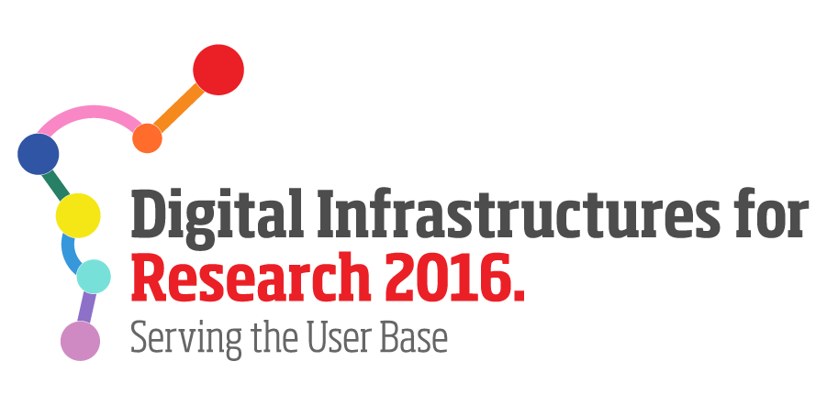
Virtual Research Environments for implementing Long-tail Open Science 30 September 2016 - Krakow
Pasquale Pagano
CNR, Italy
pasquale.pagano@isti.cnr.it

Slide 2
Context
Open Science: make scientific research, data and dissemination accessible to all levels of an inquiring society, amateur or professional
Keywords: Open Access, Open Research, Open Notebook Science
new approaches to collect-analyse-curate the data
New tools to exchange and guarantee the longevity of the data and the reusability of the experiments
Science 2.0: use network technologies to process large data sets and share experimental results and processes using a collaborative approach. Support Reproducibility-Repeatability-Reusability (R-R-R) of Science
Keywords: Provenance of the scientific process and workflows,
Collaborative and Repeatable Science

Slide 3
Long-tail Open Science
Not individual researchers but group of researchers
dynamically aggregated to address research questions/problems
are multidisciplinary, involve members belonging to diverse organisations
require to access data and services that are spread among many providers
build and operate their own supporting environments
cannot rely on pre-organised and costly supporting environments managed by dedicated organizations
wish to effectively inject open science in daily tasks
cost and time required to implement this approach
largely exceed the available capacities

Slide 4
Requirements for IT systems
Support collaborative research and experimentation
Implement Reproducibility-Repeatability-Reusability
Allow sharing data and findings
Grant open access to produced scientific knowledge and data
Tackle simplified access to existing computing and storage resources
Ensure low operational and maintenance costs
Manage heterogeneous data access policies

Slide 5
Virtual Research Environment
Created on demand
An operational environment
Where set of resources (data, services, computational, and storage resources)
are assigned to group of users via interfaces
for a limited timeframe
No cost for the resource providers
Open to host and operate custom software
Regulated by tailored policies
L. Candela, D. Castelli, P. Pagano (2013) Virtual Research Environments: An Overview and a Research Agenda. Data Science Journal, Vol. 12

Slide 6
VRE Creation
Metadata
Applications
Simple and effective process
to define a new environment
Data
Configuration

Slide 7
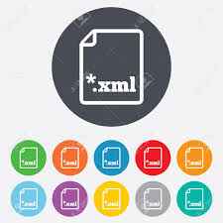
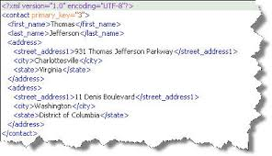
Applications vs Services
Logical View
Applications
Data
Hardware
Configuration
Registry
Physical View
Software, Tools, Services
Data

Slide 8
VREs in operation
Data Curation
Data Sharing
VRE Builder
Data Preparation
Data Publication
Security
Data Analysis
Data Provenance
Monitoring
Mediator
Connector
Mediator
Connector
Data Infrastructures
Computing Infrastructures

Slide 9
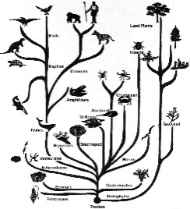
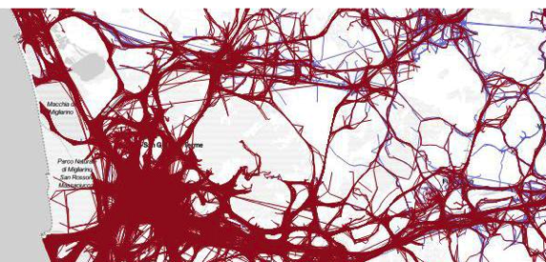
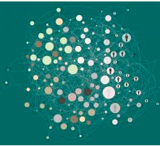
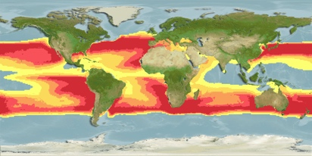
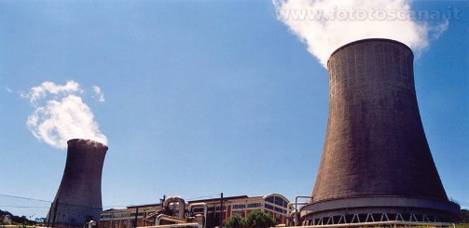
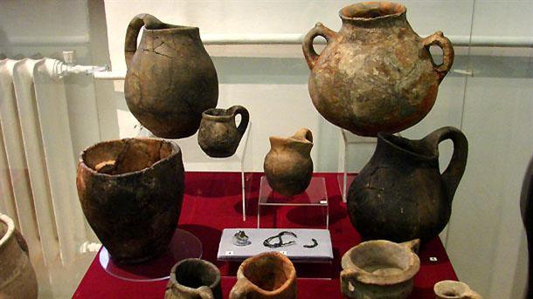
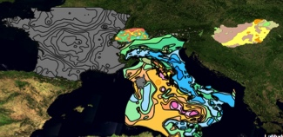
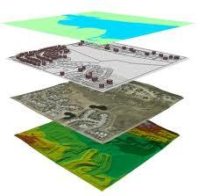
VREs in operation The D4Science e-Infrastructure
D4Science supports scientists in several domains
1. More than 25 000 taxonomic
studies per month
i-marine.d4science.org
4. Performs cross-disciplinary social mining research
sobigdata.d4science.org
2. More than 60 000 species distribution maps produced and hosted
i-marine.d4science.org
PARTHENOS
5. Enhances communication and exchange in Linguistic Studies, Humanities, Cultural Heritage, History and Archaeology
services.d4science.org
3. Used to build a pan- European geothermal energy map
egip.d4science.org

Slide 10
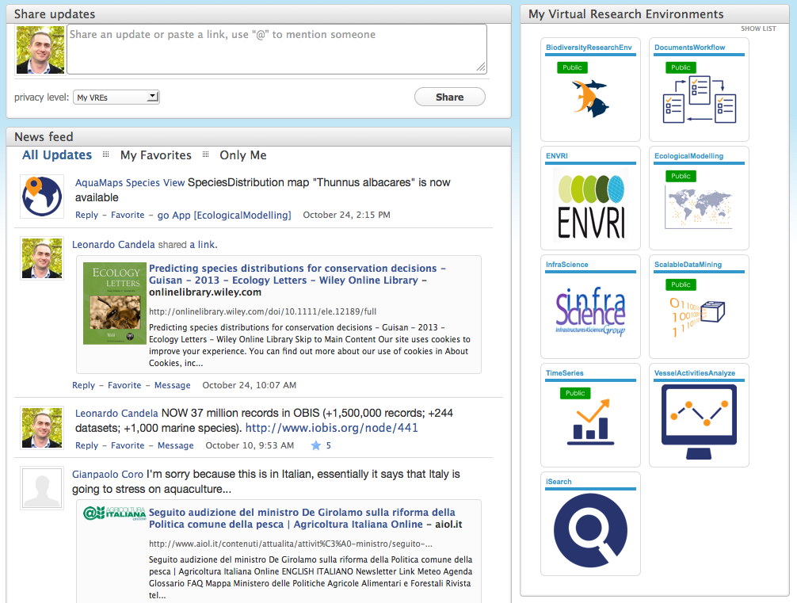
VREs: Social Networking
Social networking is key to share information in the VRE
It offers a continuously updated list of events / news produced by users and applications
Share News
Application-shared News
User-shared News

Slide 11
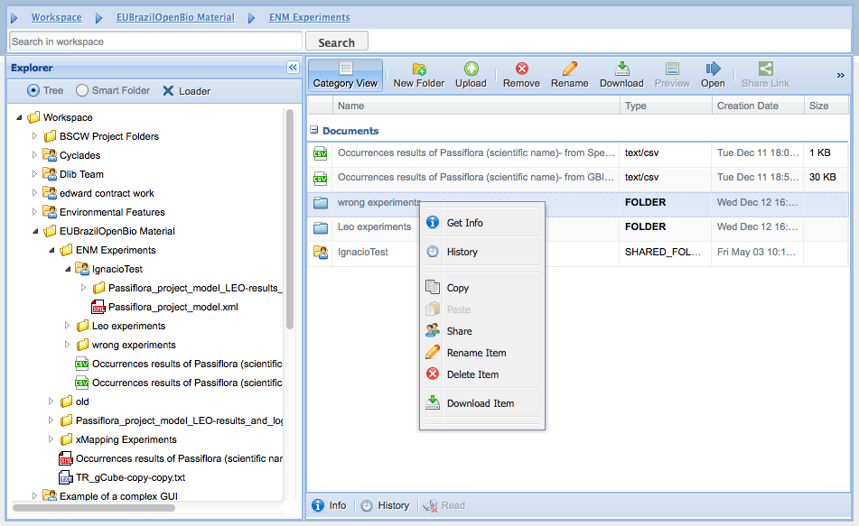
VREs: The Workspace
A folder-based file system allowing managing and sharing information objects
Information objects can be
files, dataset, workflows, experiments, etc.
organized into folders
Share with selected users
disseminate via persistent public URLs
Users can

Slide 12
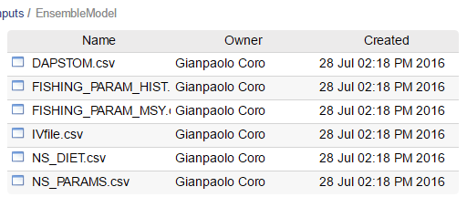
Software Integration
Scientist’s provided script
Download the (python, R, Java, …) script and the user’s data
User’s data
Execute script
Collect output
Infrastructure
Save Output on the User’s Workspace, with provenance info
Destroy local copies of I/O and script

Slide 13
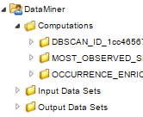
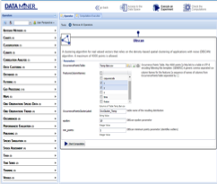
Collaborative experiments
Shared online folders
In the e-Infrastructure
Inputs
Results
Outputs
Computational system
Through third party software
WS

Slide 14
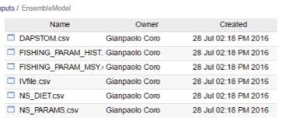
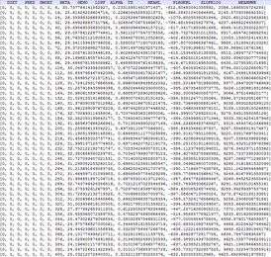
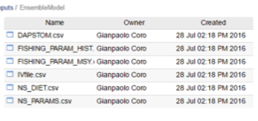
Scientific Workflow
1
Updates the script on
his private Workspace
Script provider
2
The service downloads
the script on-the-fly
9
8
This user can execute the experiment again
and share the computation with other users
4
A user executes an experiment on his/her data
7
3
5
10
The output, the input and the parameters can be shared with another user
6

Slide 15
Conclusions
VRE are defined by users and created on demand
New software can be integrated and used as-a-Service
Invoked via standard interfaces
VRE ensures
provenance management
Results on a easy-to-use storage system
Collaboration and sharing
VRE enables
Repeatability, Reproducibility and Reusability

Slide 16
Visit us at www.bluebridge-vres.eu
Try it at i-marine.d4science.org

