Slide 1
EGI Federated Cloud for developers
Giuseppe La Rocca,
Enol Fernández, Boris Parak
giuseppe.larocca@egi.eu, enol.fernandez@egi.eu,
parak@cesnet.cz
https://eduroam.egi.eu/services/cloud-compute/

Slide 2

Who we are
parak@cesnet.cz
CESNET
Leader of the Virtual Machine Management scenario in EGI
Member of the OGF OCCI Working Group
giuseppe.larocca@egi.eu
EGI Foundation
Technical Outreach Expert
Support for new communities

Slide 3
Training goals
Learn the conceptual model of the EGI Federated Cloud
Obtain skills in using the interfaces of the EGI Federated Cloud programmatically
  Discover available appliances and resources
  Manage Virtual Machines
  Manage Block Storage
  Manage credentials
Learn how to become an active user
DI4R Conference – 28th. Sept 2016 - Krakow

Slide 4
Outline
Introduction to EGI, & EGI Federated Cloud (Boris, 10’)
Accessing the training infrastructure (Giuseppe, 10’)
Exercise 1: information discovery (Giuseppe, 10’)
Exercise 2: basic OCCI and VM management (Giuseppe, 20’)
Exercise 3: Block Storage management (Giuseppe, 20’)
Exercise 4: Cleaning up (Giuseppe, 10’)
Next steps (Giuseppe, 5’)
Feedback form (Giuseppe, 5’)
DI4R Conference – 28th. Sept 2016 - Krakow
Notes:
TODOs:

Slide 5
Introduction to EGI & EGI Federated Cloud
DI4R Conference – 28th. Sept 2016 - Krakow

Slide 6








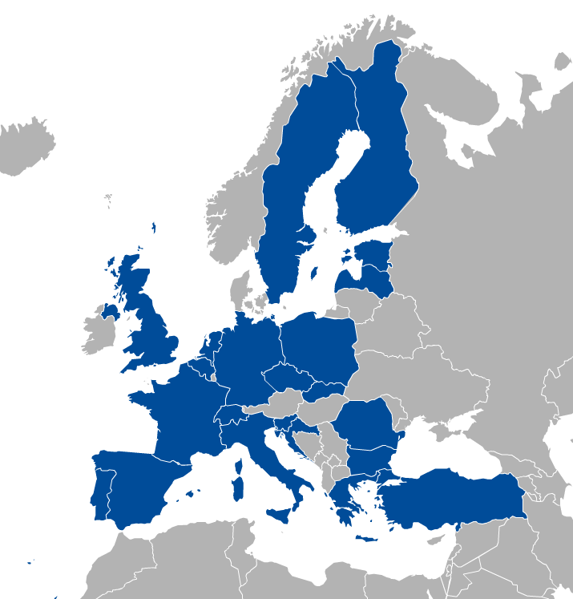





































EGI: A sustainable e-infrastructure provider for Open Science
Major national e-Infrastructures: 22 NGIs
EIROs: CERN and EMBL-EBI
EGI Foundation
(ERICs)
https://eduroam.egi.eu/about/
DI4R Conference – 28th. Sept 2016 - Krakow

Slide 7
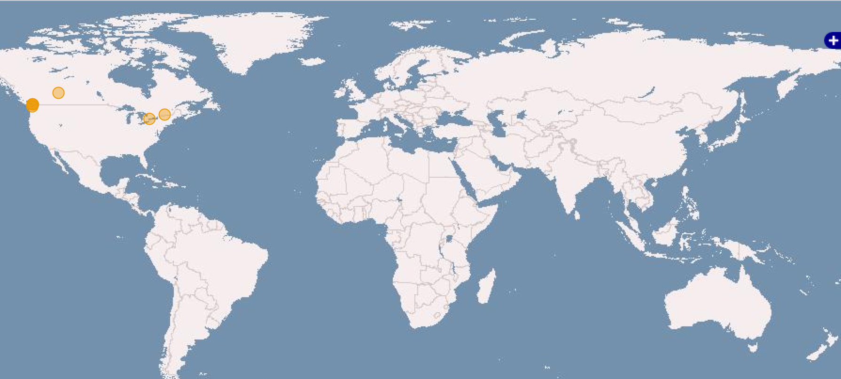
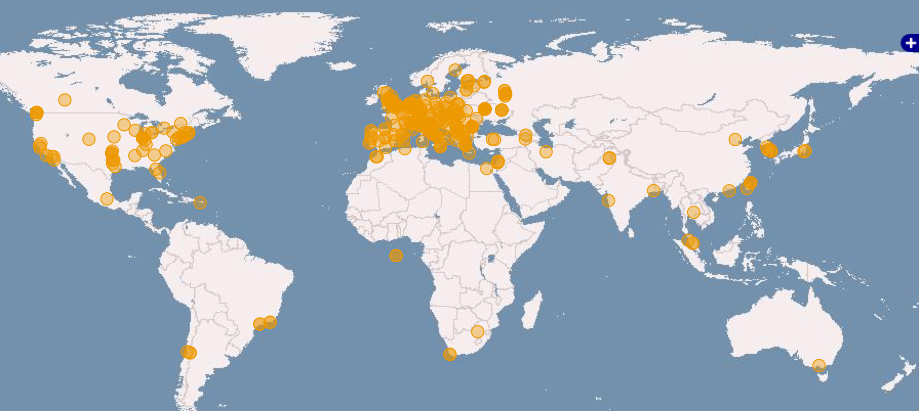

EGI infrastructure today
Russia
Ukraine
Canada
USA
Asia
Pacific
820,000 CPU Cores
+23.6%
560 PB of disk and tape storage
22 Cloud providers
325 resource providers
48,000 users
+21%
+4,000 research papers
> 790 in 2015
Latin America
Africa
Arabia
DI4R Conference – 28th. Sept 2016 - Krakow

Slide 8
Cloud computing & Key terms
Services and solutions delivered and consumed in real time over the Internet
(Some of the) benefits
  Virtualisation – Platform-independence; Self-servicing
  Scalability – ‘Pay-as-you-go’; Multi-tenant allocation
  Predictability – Versioning of VMs and contextualisation scripts
  Abstractions – IaaS, PaaS, SaaS
  Open source – KVM, OpenStack, OpenNebula, …
VM
image
App
App
App
Storage
volume
Software
Appliance
Virtual Appliance
OS
VM image
Meta data
Cloud management framework
Contextualisation script
Hardware
Virtualized Stack
DI4R Conference – 28th. Sept 2016 - Krakow

Slide 9
EGI Federated Cloud
Grid of clouds
Unified user interfaces
Harmonised operational behaviour
Clouds and their interconnections are based on open standards, open technologies
Infrastructure → Access
AND
technology → Deploy
DI4R Conference – 28th. Sept 2016 - Krakow

Slide 10



Benefits
TOPIC OF THIS TUTORIAL
VM and block storage management:
Object storage management (optional):
CDMI - on any site
OpenStack SWIFT – on OS sites
- On every site
OpenStack Nova
- On OS sites
Uniform
user interfaces
Harmonised
operation
OpenStack
OpenNebula
Cloud registry
Information system
Virt. Machine marketpl.
Usage accounting
Access control
Synnefo
OpenStack
OpenNebula
OpenStack
DI4R Conference – 28th. Sept 2016 - Krakow

Slide 11





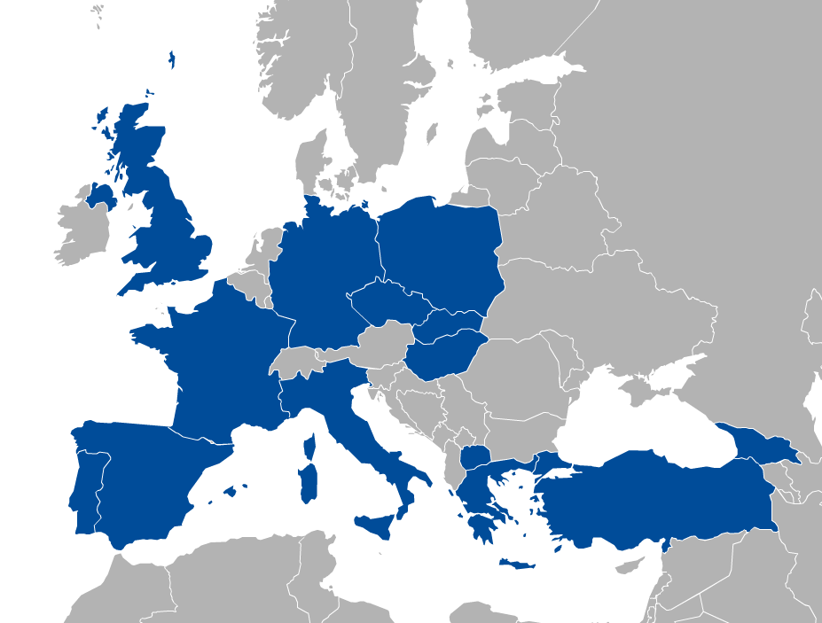










EGI Federated Cloud
EGI Federated Cloud is a collaboration of communities developing, innovating, operating and using cloud federations for research and education.
Today:
22 providers from 14 NGIs
  15 OpenStack
  6 OpenNebula
  1 Synnefo
~ 6.000 cores in total
DI4R Conference – 28th. Sept 2016 - Krakow

Slide 12
Access to the Federated Cloud:
Virtual Organisations
VO 1
(cloud a, b, c)
VO 2
(cloud b, c, d, e)
Details on “Next Steps” today
VO membership and resource
access with X.509 certificates
Generic VOs – e.g. fedcloud.egi.eu → Incubator for new users
Community-specific VOs – e.g. CHIPSTER, Highthroughtputseq, EISCAT, etc. (SLA, OLAs)
Training VO = training.egi.eu → To be used today
Browse VOs at http://operations-portal.egi.eu/vo/search (both grid and cloud)
DI4R Conference – 28th. Sept 2016 - Krakow

Slide 13
Typical usage models
Compute and data intensive workloads
  Batch and interactive (e.g. iPython-Jupyter) with scalable and customized environments
Service Hosting
  Long-running services (e.g. web server, database, application server)
Datasets repository
  Store and manage large datasets (in a storage volume)
Disposable and testing environments
  Host training environments, test applications
DI4R Conference – 28th. Sept 2016 - Krakow

Slide 14


Background on the APIs we will use today
OCCI (Open Cloud Computing Interface, OGF, 2011)
  Primarily for IaaS (manage VMs and Block Storage), extensible to other areas
  RESTFul protocol and API focusing on cloud interoperability
jOCCI: Java client API for OCCI
  To be used today
  Available from maven central
EGI AppDB
  Propietary REST API
+
DI4R Conference – 28th. Sept 2016 - Krakow

Slide 15




The typical user workflow
Exercises 2-4
Clouds in your Virtual Organisation
(e.g. training.egi.eu)
Application Portal, framework, SaaS, etc..
OCCI calls
(CMD/API)
VM
VM
VM
REST API
VM
VM
VM
REST API
OCCI calls
(CMD/API)
VM
Storage
VM
Appliances Marketplace (AppDB)
Virtual/Software Appliances of your Virtual Organisation
Exercise 1
VM
VM
VM
VM
VM
VM
Get IDs of
Cloud endpoint
VA image
Resource template
VM
VM
VM
http://appdb.egi.eu → Cloud Marketplace
DI4R Conference – 28th. Sept 2016 - Krakow

Slide 16
Accessing the training infrastructure
DI4R Conference – 28th. Sept 2016 - Krakow

Slide 17
training.egi.eu Virtual Organisation
Site | Available capacity in the VO
CESNET (CZ) | 64 vCPUs 110 GB of RAM 1 TB of persistent storage
BIFI (ES) | 50 vCPUs 50 GB of RAM 50 storage volumes 50 public IP addresses
UKIM (MK) | 48 vCPUs 48 GB of RAM 48 public IP addresses
CETA-CIEMAT (ES) | 20 vCPUs 40 GB of RAM 5.4 TB storage 10 public IP addresses
INFN (IT) | 20 vCPUs 50 GB of RAM 1 TB storage 10 public IP addresses
CESNET (OpenNebula)
UI
BIFI (OpenStack)
UKIM
(OpenNebula)
CETA-CIEMAT
(OpenStack)
INFN
(OpenStack)
Trainers join VO with X.509 personal certificates → Generate own proxy for access
Trainees get proxies from trainers. Your proxy is valid for 24 hours
  You will need personal certificate from a recognised CA for the long-term – More later!
DI4R Conference – 28th. Sept 2016 - Krakow

Slide 18
Before starting
Accessing the EGI Federated Cloud clients Virtual Appliance (UI):
  UI Server ➔ XXX.XXX.XXX.XXX Port ➔ 4422
  Username ➔ userX, where X=1,..,29
  Password ➔ FedCloudUserX, where X=1,..,29
Check your proxy file:
Check the lifetime of your credentials:
Access VMs via SSH:
VMs are (normally) accessible through SSH:
  But password logins are disabled
  Create your SSH public key:
]$ echo $X509_USER_PROXY
]$ voms-proxy-info –all
]$ ssh-keygen (do NOT specify any password!)

Slide 19

Source codes, docs & requirements
Repository:
The repository containing the exercises/instructions for the training even on how to use the EGI Federated Cloud API can be found on-line https://github.com/EGI-FCTF/di4r-training
Download the repository:
]$ git clone https://github.com/EGI-FCTF/di4r-training.git
Requirements:
For compiling most exercises you will need:
Java SDK 7+
Maven
Digital Certificates:
You will need a trusted X.509 certificate to generate proxy and to belong to the training Virtual Organisation supported at the EGI cloud providers.
DI4R Conference – 28th. Sept 2016 - Krakow

Slide 20
Source code and Java Docs
Repository:
https://github.com/EGI-FCTF/jOCCI-api
https://github.com/EGI-FCTF/jOCCI-core
Java Docs:
egi-fctf.github.io/jOCCI-core/apidocs/index.html
egi-fctf.github.io/jOCCI-api/apidocs/index.html
DI4R Conference – 28th. Sept 2016 - Krakow

Slide 21
Exercise 1:
Querying the EGI
Application Database
In this exercise we will show how it is possible to use the EGI Application Database REST API and get information about the certified cloud providers
    Duration: 10 min.
DI4R Conference – 28th. Sept 2016 - Krakow

Slide 22
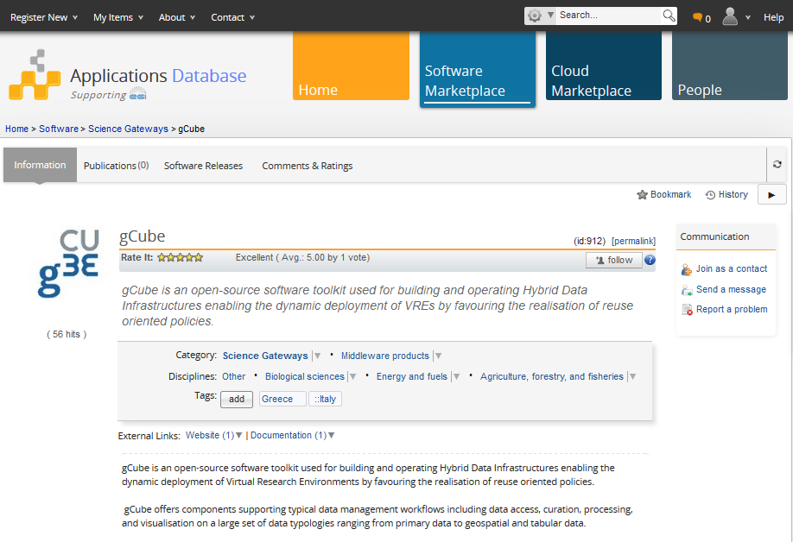
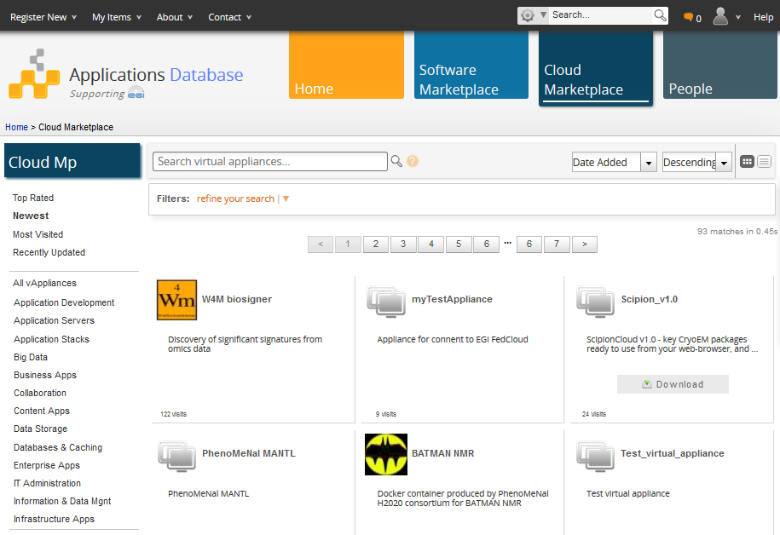
The EGI Application DataBase https://appdb.egi.eu/
The EGI Application DataBase (AppDB) is a central service that stores and provides information about:
  Software solutions in the form of native software products, virtual appliances and/or software appliances,
  the programmers and the scientists who are involved, and
  publications derived from the registered solutions.
DI4R Conference – 28th. Sept 2016 - Krakow

Slide 23
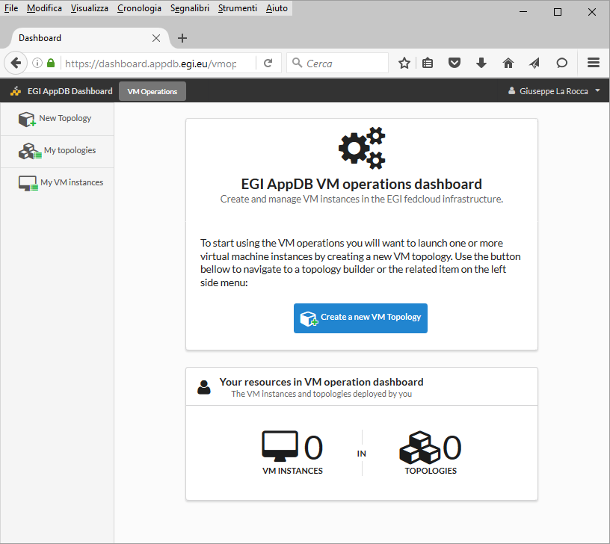
The EGI Application DataBase https://appdb.egi.eu/
The EGI AppDB is currently evolving to include a graphical user interface (a dashboard) allowing authorized users to perform some basic VM management operations.
EGI AppDB and REST technology
  The base URI of the RESTful API is the following:
  http://appdb-pi.egi.eu/rest/1.0
  Requests must be followed by at least a resource name, which may be followed by one or more sub-resource names separated by slashes:
    http://appdb-pi-egi.eu/rest/1.0/applications/
    http://appdb-pi-egi.eu/rest/1.0/va_providers/
    http://appdb-pi-egi.eu/rest/1.0/va_providers/8253G0
DI4R Conference – 28th. Sept 2016 - Krakow

Slide 24
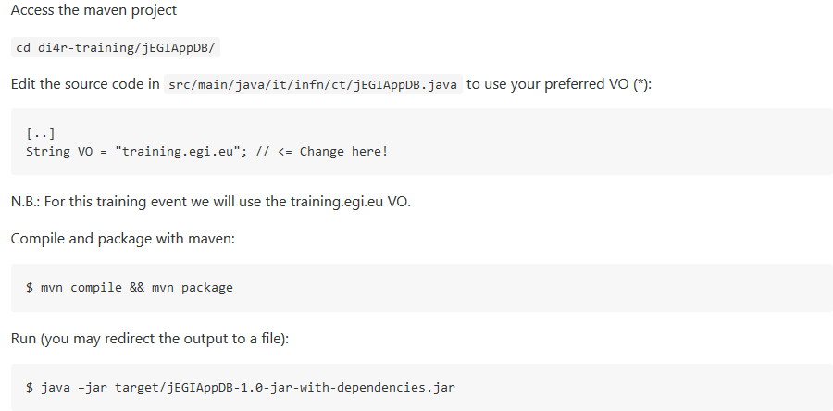
Querying the EGI AppDB https://github.com/EGI-FCTF/di4r-training/tree/master/jEGIAppDB
Use the jEGIAppDB project to get the list of cloud providers that have subscribed the training VO.
DI4R Conference – 28th. Sept 2016 - Krakow

Slide 25
Querying the EGI AppDB https://github.com/EGI-FCTF/di4r-training/tree/master/jEGIAppDB
For each provider the available Virtual Appliances and resource templates will be shown.
Choose one of the available provider publishing the Jupyter Notebook VA and identify the following IDs:
    The cloud provider endpoint you want to use
    The Jupyter Notebook VA image ID for that provider
    The resource template ID the VM should use (smallest!)
Save these IDs for the next exercises!
For Python developers ➔
https://github.com/EGI-FCTF/di4r-training/tree/master/pyEGIAppDB
DI4R Conference – 28th. Sept 2016 - Krakow

Slide 26
Exercise 2:
Start your Jupyter Notebook in the EGI FedCloud infrastructure
In this exercise we will show how use the jOCCI APIs to:
Create your Jupyter Notebook in one of the cloud providers of the EGI federation
  Specify the contextualization script to inject your SSH public-key and run a script at boot time
Get the IP address of your running server
Attach a public network IP (if necessary)
Access the Jupyter Notebook via SSH/Web
    Duration: 20 min.
DI4R Conference – 28th. Sept 2016 - Krakow

Slide 27
Contextualization
What?
  Contextualization is the process of installing, configuring and preparing software upon boot time on a pre-defined virtual machine image
  e.g. hostname, IP address, ssh keys, …
Why?
  Configuration not known until instantiation (e.g. data location)
  Private Information (e.g. host certs)
  Software that changes frequently or under development
  Not practical to create a new VM image for every possible configuration
DI4R Conference – 28th. Sept 2016 - Krakow

Slide 28
Contextualization in FedCloud
Contextualization requires passing some data to the VMs on instantiation (the context)
OCCI extensions specify how to pass context to the VM
  BUT not how the data will be available!
Each cloud provider can have different mechanisms
  metadata server at a known location
  iso filesystem attached to the VM
  file injection into the VM image
  …
cloud-init is the preferred tool to abstract this, all VA in FedCloud include it!
DI4R Conference – 28th. Sept 2016 - Krakow

Slide 29
cloud-init
cloud-init abstracts the different ways of providing context to the VM and defines a format for the data
cloud-init is able to:
  configure network, users, ssh keys, filesystems,
  install packages,
  execute arbitrary commands,
  execute user provided scripts,
  invoke puppet or chef for configuration
  …
cloud-init documentation contains examples for all the supported options: http://cloudinit.readthedocs.org/
DI4R Conference – 28th. Sept 2016 - Krakow

Slide 30
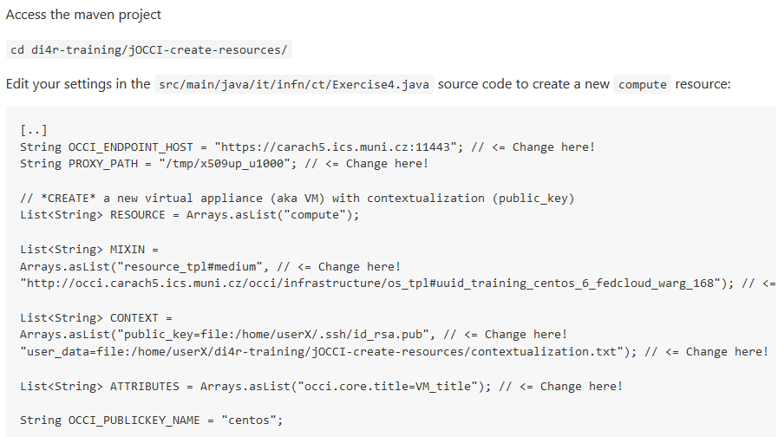
Start the Jupyter Notebook https://github.com/EGI-FCTF/di4r-training/tree/master/jOCCI-create-resources
Use the jOCCI-create-resources project to create a Jupyter Notebook :
Use the cloud provider endpoint, the resource template ID and the VA image ID you have found!
DI4R Conference – 28th. Sept 2016 - Krakow

Slide 31
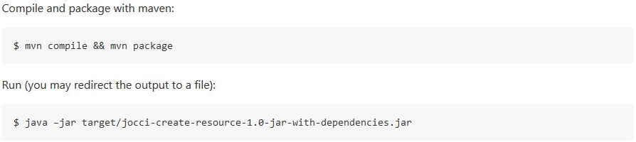

Start the Jupyter Notebook https://github.com/EGI-FCTF/di4r-training/tree/master/jOCCI-create-resources
Start your Jupyter Notebook and save the OCCI VM ID!
DI4R Conference – 28th. Sept 2016 - Krakow

Slide 32
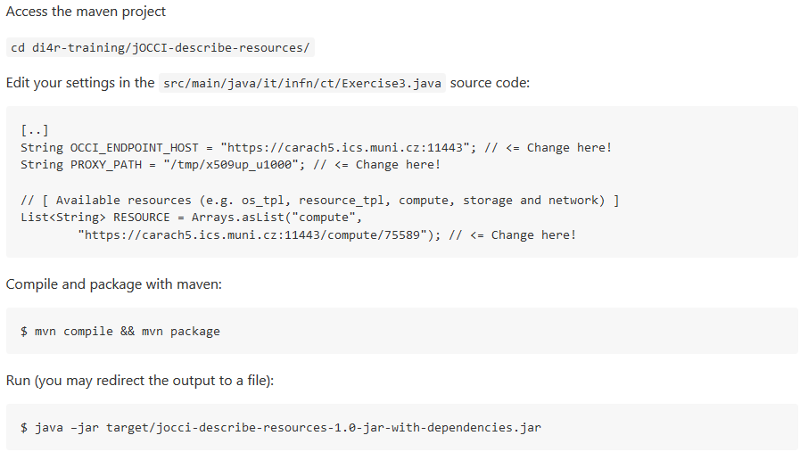
Get attributes about your Jupyter Notebook https://github.com/EGI-FCTF/di4r-training/tree/master/jOCCI-describe-resources
Use jOCCI-describe-resources project to get the network IP
Check the occi.networkinterface.address tag to get the IP address
DI4R Conference – 28th. Sept 2016 - Krakow

Slide 33

VM Networking https://github.com/EGI-FCTF/di4r-training/tree/master/checkIP https://github.com/EGI-FCTF/di4r-training/tree/master/jOCCI-list-resources https://github.com/EGI-FCTF/di4r-training/tree/master/jOCCI-attach-resources
No
Does your Jupyter Notebook has
a public IP address ?
Yes
Access the Jupyter Notebook server
(next slide)
  ➔ Use the checkIP utility to check if an IP address is public/private
  ➔ Use the jOCCI-list-resources source code to list the public network ID of your selected provider
  Use the jOCCI-attach-resources source code to attach the public network ID to your active VM
DI4R Conference – 28th. Sept 2016 - Krakow

Slide 34
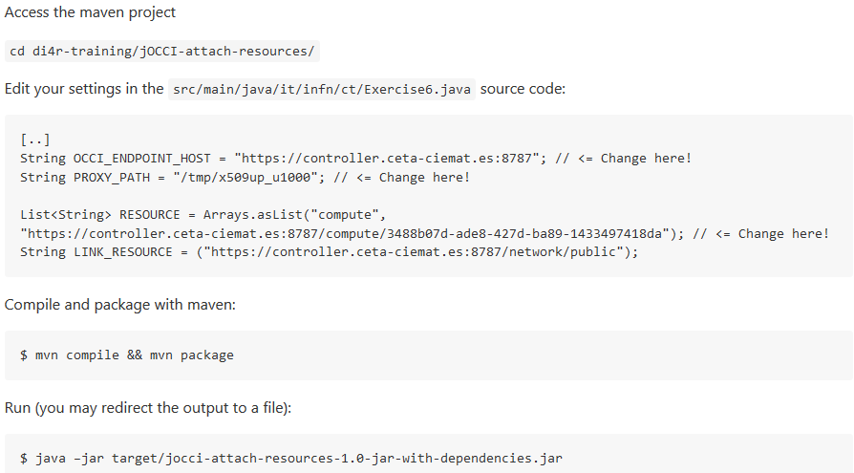
Attach a public network https://github.com/EGI-FCTF/di4r-training/tree/master/jOCCI-attach-resources
Use jOCCI-attach-resources project to attach a public IP address

Slide 35
Logging into the Jupyter Notebook
Access with the public IP and check the list of kernels supported by your Jupyter Notebook server:
]$ ssh centos@<VM_PUBLIC_IP>
]$ jupyter-kernelspec list
Start the Jupyter Notebook server:
]$ jupyter notebook
Connect to your Jupyter Notebook:
Open your web browser at this URL: https://<VM_PUBLIC_IP>:8888
DI4R Conference – 28th. Sept 2016 - Krakow

Slide 36
Exercise 3:
Create a persistent storage
In this exercise we will show how use the jOCCI APIs to:
Create and describe the information of the block storage
Attach the block storage to the active VM
Manage the block storage
    Duration: 20 min.
DI4R Conference – 28th. Sept 2016 - Krakow

Slide 37
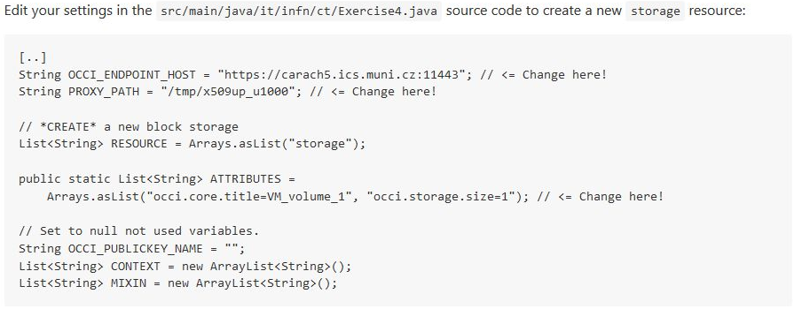
Create a block storage https://github.com/EGI-FCTF/di4r-training/tree/master/jOCCI-create-resources
Use jOCCI-create-resources project create a block storage
DI4R Conference – 28th. Sept 2016 - Krakow

Slide 38
Create a block storage https://github.com/EGI-FCTF/di4r-training/tree/master/jOCCI-create-resources
Create and save the Block Storage ID!
DI4R Conference – 28th. Sept 2016 - Krakow

Slide 39
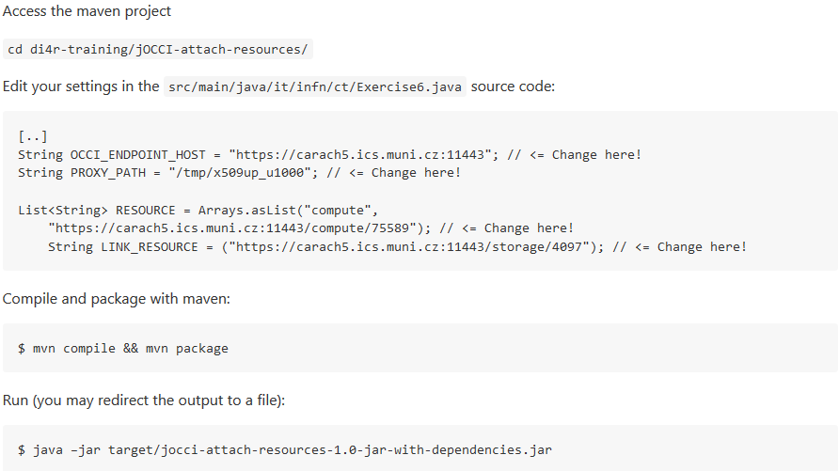
Attach the block storage https://github.com/EGI-FCTF/di4r-training/tree/master/jOCCI-attach-resources
Use jOCCI-attach-resources project to attach the block storage to your Jupyter Notebook server
Use the OCCI VM ID and the
Block Storage ID that you
have created
DI4R Conference – 28th. Sept 2016 - Krakow

Slide 40
Get attributes about your Jupyter Notebook https://github.com/EGI-FCTF/di4r-training/tree/master/jOCCI-describe-resources
Use jOCCI-describe-resources project to get the info about the attached block storage (see previous slides)
[…]
Links:
[[ http://schemas.ogf.org/occi/infrastructure#storagelink ]]
>> location: /link/storagelink/compute_75589_disk_2
occi.core.id = compute_75589_disk_2
occi.core.title = VM_volume_1
occi.core.target = /storage/4097
occi.core.source = /compute/75589
occi.storagelink.deviceid = /dev/vdc
occi.storagelink.state = active
[…]
Storage Link ID
Block Storage ID
We will need this at the VM to manage the volume
DI4R Conference – 28th. Sept 2016 - Krakow

Slide 41
Mount your block storage
]$ ssh centos@<VM_PUBLIC_IP>
]$ sudo mkfs.ext3 /dev/vdc
]$ sudo mount /dev/vdc /mnt
Check the new partition
]$ df -h
]$ sudo umount /mnt
DI4R Conference – 28th. Sept 2016 - Krakow

Slide 42
Exercise 4:
Clean up, detach and delete resources
In this exercise we will show how use the jOCCI APIs to detach and delete all the allocated resources
    Duration: 10 min.
DI4R Conference – 28th. Sept 2016 - Krakow

Slide 43

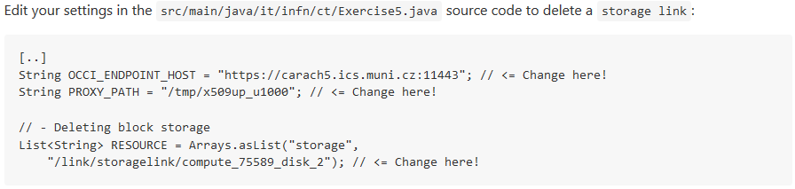
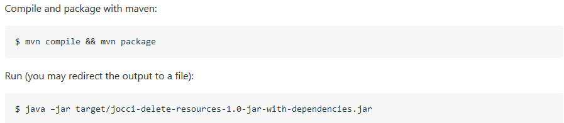
Clean up! https://github.com/EGI-FCTF/di4r-training/tree/master/jOCCI-delete-resources
Use jOCCI-delete-resources project to delete the storage link
DI4R Conference – 28th. Sept 2016 - Krakow

Slide 44
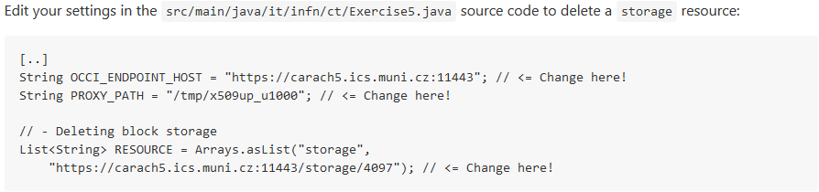
Clean up! https://github.com/EGI-FCTF/di4r-training/tree/master/jOCCI-delete-resources
Use jOCCI-delete-resources project to delete the block storage
DI4R Conference – 28th. Sept 2016 - Krakow

Slide 45
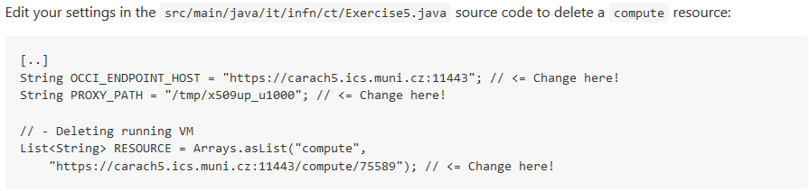
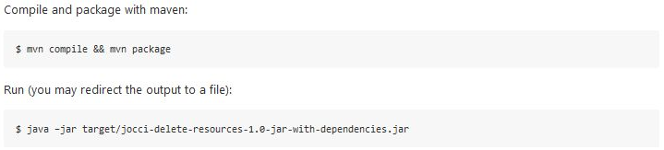
Clean up! https://github.com/EGI-FCTF/di4r-training/tree/master/jOCCI-delete-resources
Use jOCCI-delete-resources project to delete the compute resources
DI4R Conference – 28th. Sept 2016 - Krakow

Slide 46
Next Steps
DI4R Conference – 28th. Sept 2016 - Krakow

Slide 47
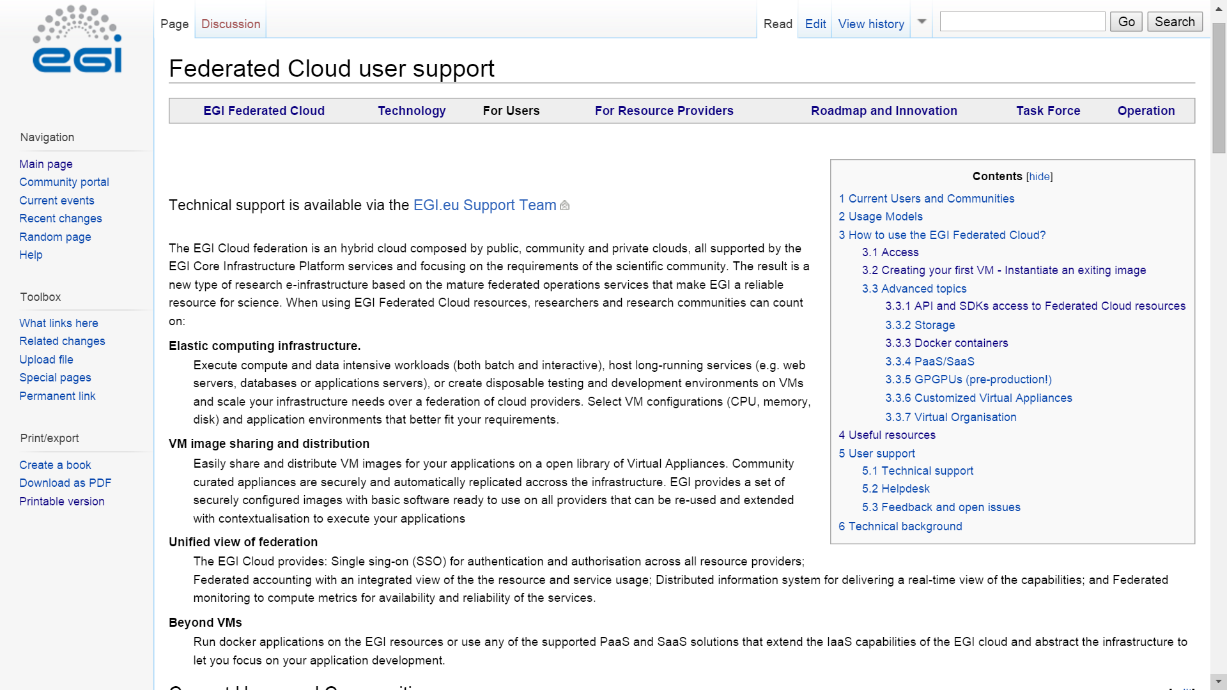
EGI FedCloud Documentation and Guides
https://wiki.egi.eu/wiki/Federated_Cloud_user_support
API/SDK info at https://wiki.egi.eu/wiki/Federated_Cloud_APIs_and_SDKs
DI4R Conference – 28th. Sept 2016 - Krakow

Slide 48
Getting access to the FedCloud
Obtain certificate: Once
Renew certificate: Annually
Your step-by-step list:
  Obtain certificate from
    National CA (face-to-face identity check)
    http://www.igtf.net
    OR
    Terena Certificate Service: (online) https://www.digicert.com/sso
  Register at the VO
    fedcloud.egi.eu is a good starting point
    Other VOs: http://operations-portal.egi.eu/vo/search
  VO manager authorizes You
    Membership DB updated
    Identity replicated to resource within 1 day
  Interact with the resources
    OCCI API
You
CA
Join VO: Once
VIRTUAL
ORGANISATION
Use
resources
VO manager
Register
Membership service
User database
Cloud sites
DB replication
(once a day)
DI4R Conference – 28th. Sept 2016 - Krakow

Slide 49
Exercise 5:
Create a proxy certificate programmatically
(no need to run)
In this exercise we will show how it is possible to use the Java VOMS API to create a proxy certificate
DI4R Conference – 28th. Sept 2016 - Krakow

Slide 50
Creating a proxy certificate https://github.com/EGI-FCTF/di4r-training/tree/master/API-VOMS-CANL
Before accessing the resources you need a VOMS proxy
  Short lived credential from your certificate
  With extra information about your VO membership
Creation can be done with:
  voms-proxy-init command line client
  Java APIs
You need to upload your public/private certificate into the EGI FedCloud UI
  $HOME/.globus/
DI4R Conference – 28th. Sept 2016 - Krakow

Slide 51
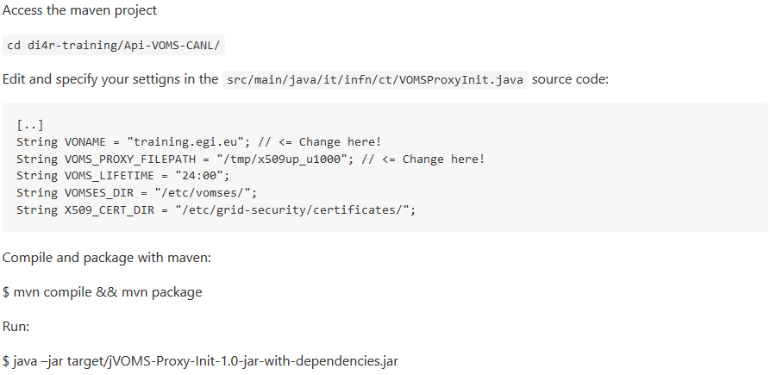
Creating a proxy certificate https://github.com/EGI-FCTF/di4r-training/tree/master/API-VOMS-CANL
DI4R Conference – 28th. Sept 2016 - Krakow

Slide 52
Support services
Dedicated technical consultancy for any user or community:
support@egi.eu
F2F/Web Meetings
Identify suitable setup
Technical integration
Continuous tracking and support
Periodic meetings
Fedcloud.egi.eu VO
Resources for prototyping
Allocate technical experts
Define milestones
Usable for 2x6 months
Enabled on all sites
Doc
Step by step guides
Secure, up-to-date
Migration to production
Identifying committed resource providers
EGI VM Images
Contextualisation
Examples
Tutorials – CMD line, API
Main OS versions
Support for VO setup
SLAs, OLAs
Docker
DI4R Conference – 28th. Sept 2016 - Krakow

Slide 53
PLEASE FILL IN THE FEEDBACK FORMS!
https://www.surveymonkey.com/r/PYH5RNP

