Slide 1
Copernicus
Data & Information
Access Service
→ DIAS
28 September 2016

Slide 2
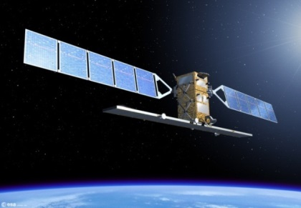
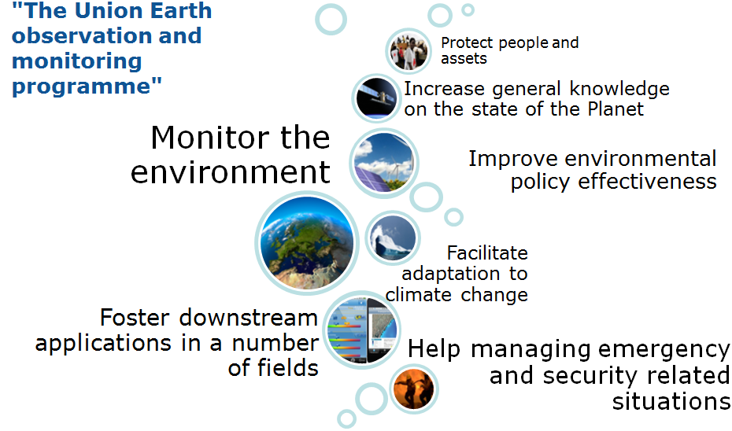



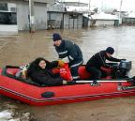
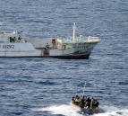
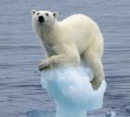
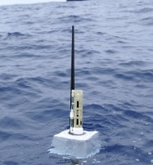
Copernicus
Sentinels/other satellites
6 Copernicus services
User Perspective:
Full – Free – Open
Continuity
Global coverage
Frequent update
Significant Volume
… but how to
Access?
Add Value?
in-situ
…added-value information
Notes:
Nicolaus Copernicus was a Renaissance mathematician and astronomer who formulated a model of the universe that placed the Sun rather than the Earth at the center of the universe.
February 19, 1473, Toruń, Poland to May 24, 1543, Frombork, Poland

Slide 3
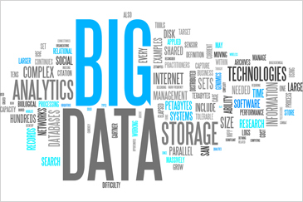
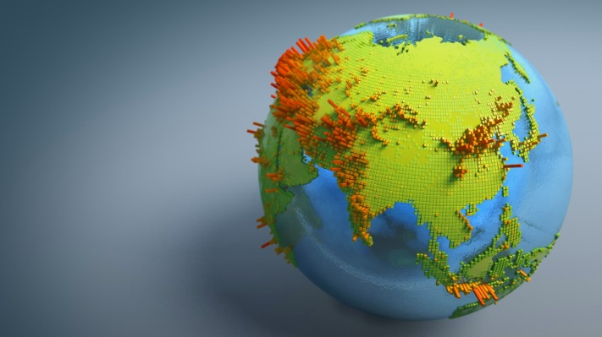
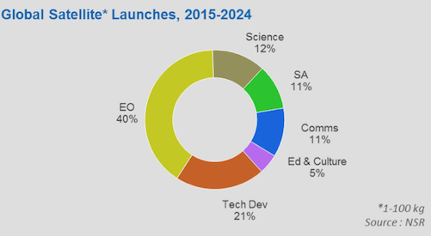

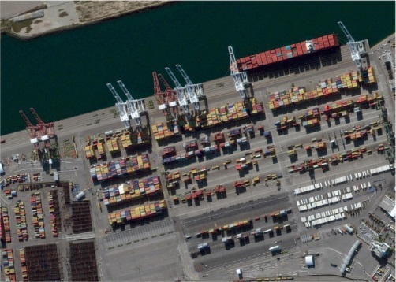
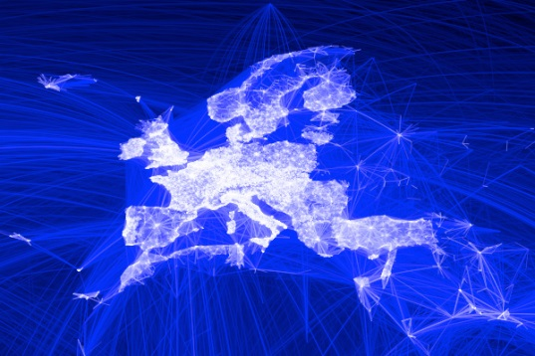
Context
Copernicus – full, free, open & continuity
New applications built on/using Earth Observation information
The Digital Revolution – Big Data, Cloud, HPC, IoT
Commoditisation of Earth Observation data
Commercial initiatives (not only)
in US – private capital
New and flexible value chains
International competition

Slide 4






DIAS Concept
User Domain
Commission
Member States
Private sector
Citizen
Regional/Local
Administration
Scientific users
ESA / EUMETSAT
Processing & Other Value Added Services &
Data
Processing & Other Value Added Services &
Data
User Data
Information Access & Download
R & D initiatives
e-infrastructure
Copernicus Core Services
Copernicus Domain
Land
Data for Download
Data/Information Access on Cloud
Marine
Atmosphere
Data Distribution service
Data and Information Access Service
Emergency
Security
S1
S2
S3
S4
S5
S6
Sentinel
Data
Service Information
Climate
Sentinels
improved
new
Service Information
Sentinel Data
ESA
Sentinel Data
EUMETSAT
Contributing Missions
In-Situ
National, International & Commercial Data

Slide 5
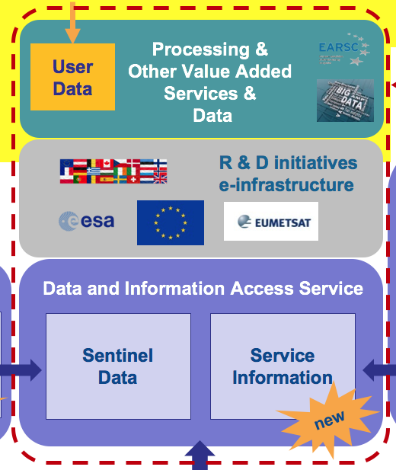
Copernicus DIAS
A service approach
Commission ensures access to Copernicus data and information
Non-exclusive – open for all
Combining European supply & demand to provide critical mass
Industry-led, scalable
Facilitates transition from research and innovation to production environment
Opportunity:
  Integrate into e-infrastructure & provide access to scientific community - free at the point of use
Front-office
Back-office

Slide 6
Copernicus DIAS
Functional scope
  Access
  Discovery
  Visualisation
  Integration layer to support user initiatives
Additional offerings – free or paid for
(open business models)
  Processing
  Access to other data
  Tools
  Market places
  ….
Open & non-discriminatory
Competitive, open to industrial initiatives
Front-office
Back-office

Slide 7


Complementarity
Market Place
Contribution
to GEO
The Copernicus data and information access initiative will build on and enrich other efforts within and outside the Commission.
We will step up our coordination effort to target alignment of objectives and mutual support amongst actors.
Copernicus
EO Innovation Europe
European
Big Data
Initiative
Collaborative
Ground Segment

Slide 8
Thank you for your attention!

